Slide 1


Moto Vlogs Analysis
An event-based frequency analysis of road hazards, infrastructure challenges, and traffic dynamics.

Slide 2



Observation
8
133m 11s
Total Watch Time
Videos Analyzed
Over 2 hours of active footage.
Complete logs reviewed.

Slide 3





Methodology & Categorization
Observation
Classification
Quantification
Systematically reviewed 8 moto vlog segments, vlogging start and end times for every discernible traffic event.
Events were normalized and grouped into distinct categories (e.g., "Pedestrian Activity", "Traffic Flow") to identify core trends.
Calculated frequency counts for each category to determine the "Dominant Hazard" and "Infrastructure Load".

Slide 4

Event & Category Overview
215+
12
Total Events Logged
Distinct Categories
Across approx. 2 hours of footage.
Ranging from infrastructure to animals.

Slide 5
Detailed Event Inventory
Event Category | Count | Description / Notes
Pedestrian Activity | 56 | Walking, jaywalking, or standing on road.
Speed Breakers & Bumps | 52 | Physical speed reducers and road bumps.
Overtaking | 28 | Rider passing others or being passed.
Crossings & Intersections | 20 | Vehicles crossing the rider's path at junctions.
Wrong Side Driving | 14 | Vehicles approaching in the rider's lane (high risk).
Vehicle Ahead | 14 | Following distance behind other vehicles.
Traffic Jam | 9 | Standstill congestion or heavy gridlock.
Potholes/Road Defects | 7 | Significant damage to road surface.
Animal Activity | 4 | Dogs, cows, or other animals on carriageway.
Rickshaw Interaction | 4 | Interaction with slow-moving 3-wheelers.
Vehicle Parking | 4 | Vehicles entering or leaving parking spots.
Others | 4 | Includes accidents (1), tunnels (1), security checks (1).

Slide 6
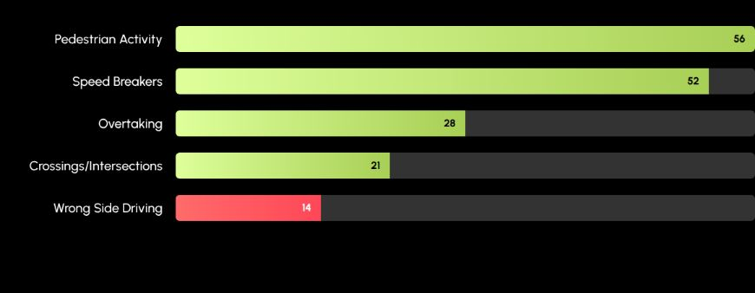
Top 5 Event Frequencies
Pedestrians and Speed Breakers are the dominant factors, accounting for over 50% of all events.

Slide 7


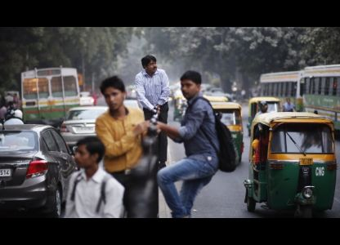
Insight 1: Vulnerable Road Users
Pedestrian Activity
With 56 occurrences, pedestrian activity is the single most critical factor in the South Asian riding environment.
•
High frequency of "jaywalking" or mid-block crossings.
•
Pedestrians often share the carriageway due to lack of sidewalks.

Slide 8
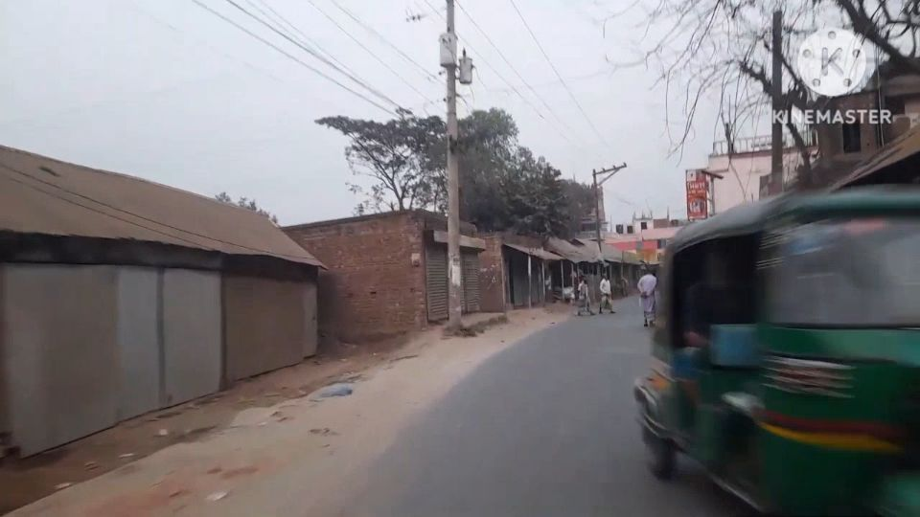
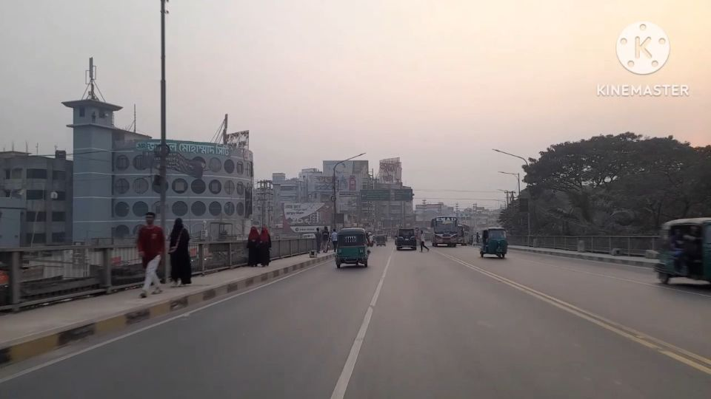
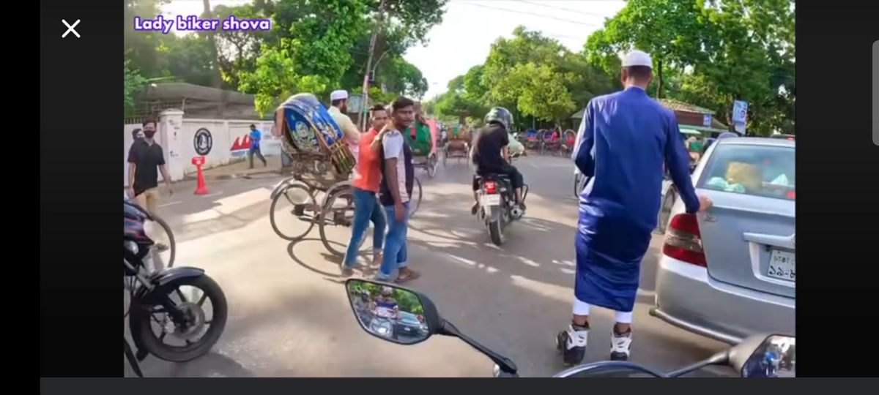
Vulnerable Road Users : More Example
•

Slide 9
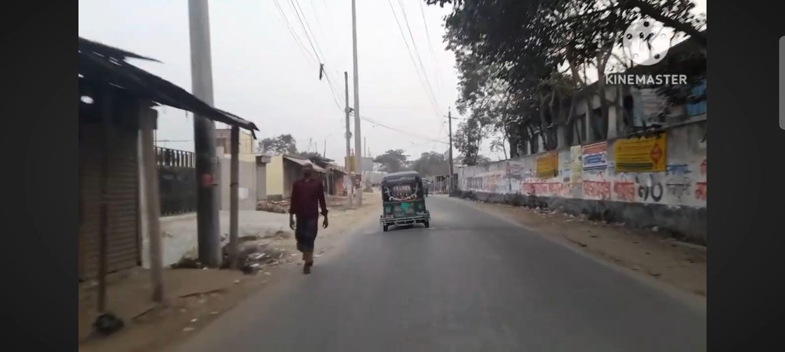

Insight 2: Speed Breaker, Bumps & pothole as Obstacle
Flow Interruption
The data recorded 52+ instances of Speed Breakers, Road Bumps, or Potholes.
"The road itself acts as a regulator. The high density of speed breakers forces a stop-and-go rhythm that increases travel time and physical fatigue for the rider."

Slide 10
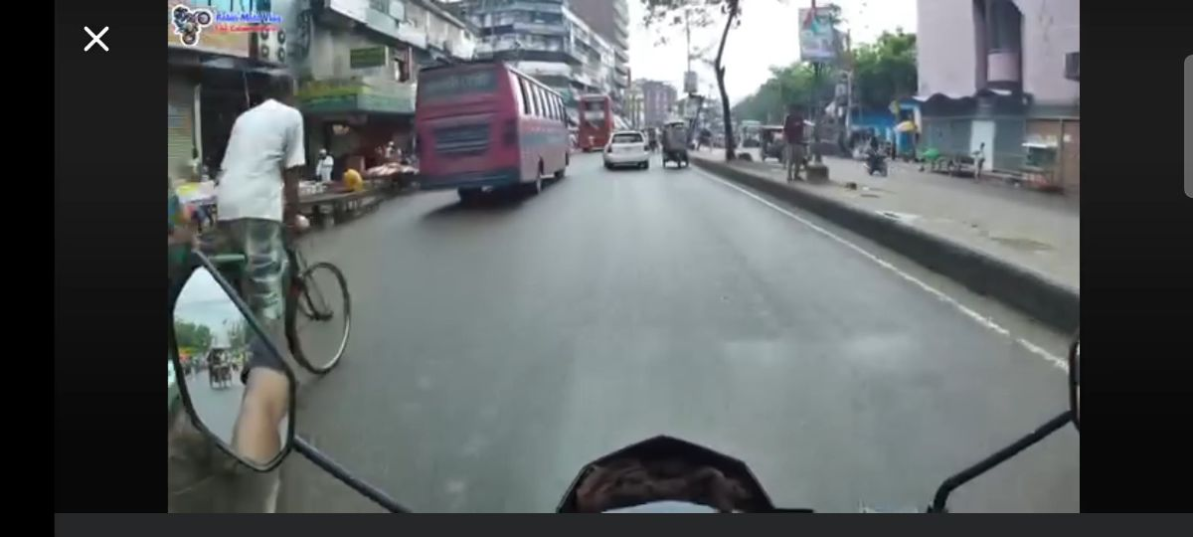
Insight 3: Wrong Side Driving
Wrong Side Driving
A specific and dangerous phenomenon observed in the data is vehicles approaching from the wrong direction (14 counts).
Unlike static obstacles like speed breakers, this is a dynamic and high-risk hazard that violates standard traffic expectations, requiring elite defensive driving skills to navigate safely.

Slide 11


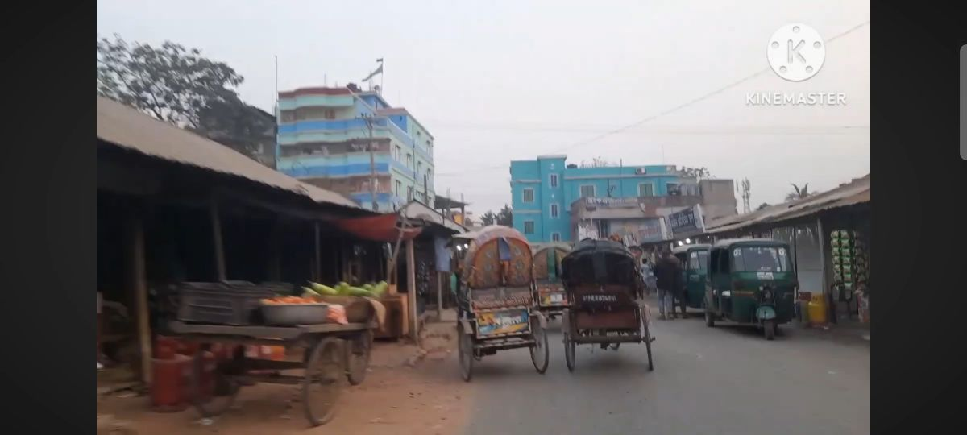
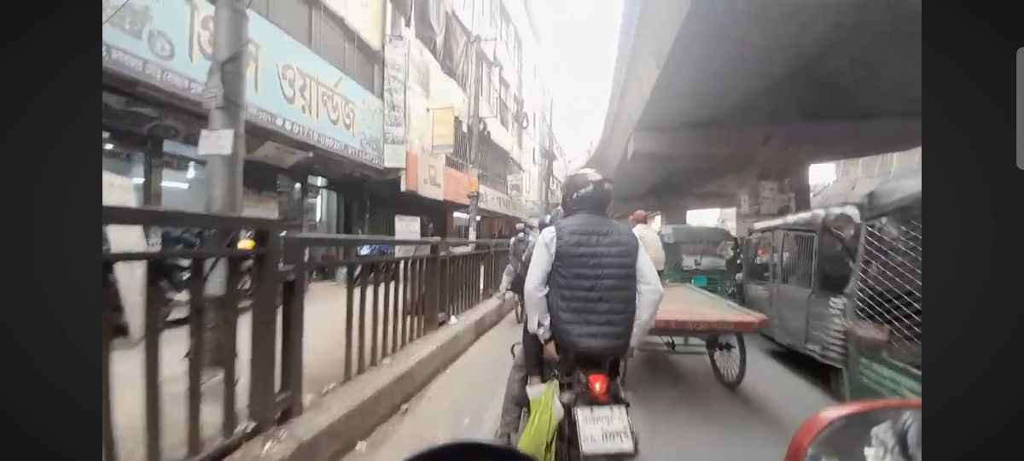
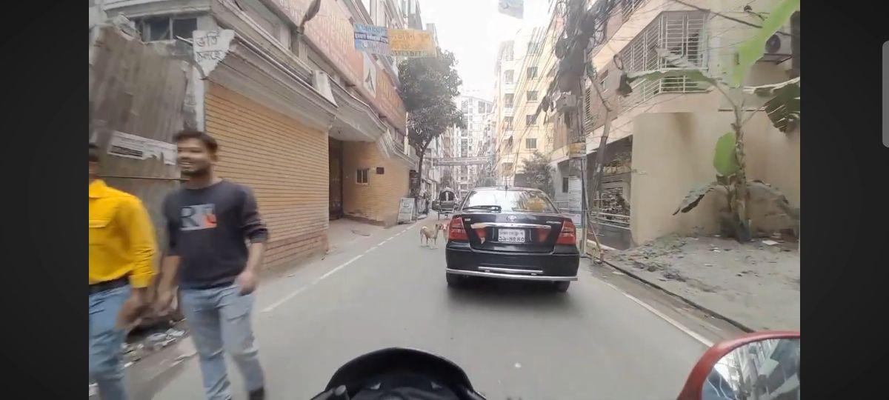
Regional Context
Rickshaws
Traffic Density
Animal Activity
Slow-moving traffic mix
High volume in narrow spaces
Unpredictable biological hazards

